Slide 1

Data Analysis
Dr. Kaung Myat Khant

Slide 2
Let’s see what we should do with the data we acquired
Here, we’ve got simulated data of 10,000 users from dating apps such as tinder, match ,etc.

Slide 3
But the data is really messy
id | age_female | age_male | match_age_female | match_age_male
1 | 28 | 99 | 25 | 99
2 | 99 | 28 | 99 | 21
3 | 20 | 99 | 19 | 99
4 | 99 | 22 | 99 | 18
5 | 19 | 99 | 18 | 99

Slide 4
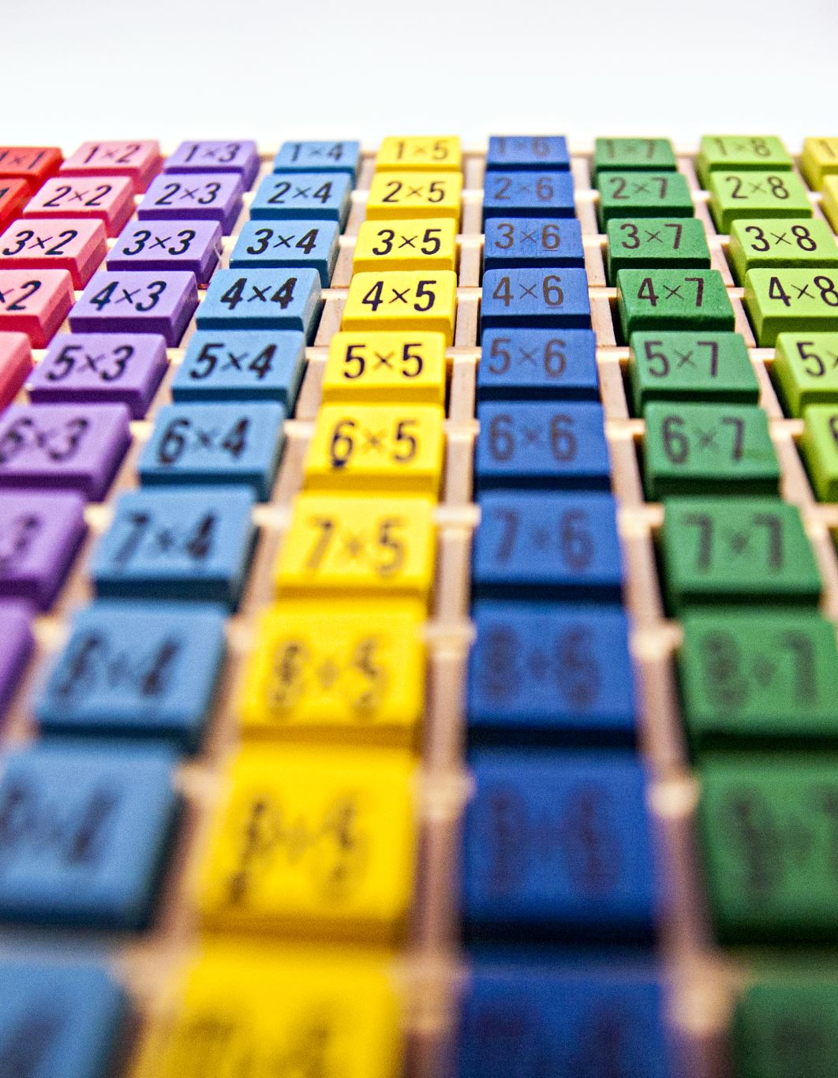
So we run a few codes to tidy up
data %>% pivot_wider(id_cols = id, names_from = gender, values_from = c(age, match_age), values_fill = 99) %>% pivot_longer(cols = -id, names_to = c(".value", "gender"), names_pattern = "(age|match_age)_(female|male)") %>% mutate(across(c(age, match_age), ~ na_if(., 99))) %>% filter(complete.cases(.))

Slide 5
And we get this tidy data and now our data has meaning
id | gender | age | match_age
1 | female | 28 | 25
2 | male | 28 | 21
3 | female | 20 | 19
4 | male | 22 | 18
5 | female | 19 | 18

Slide 6


We use statistics to see what we could know from our data
$$matched_age=α+β_{1}×age+β_{2}×gender$$

Slide 7
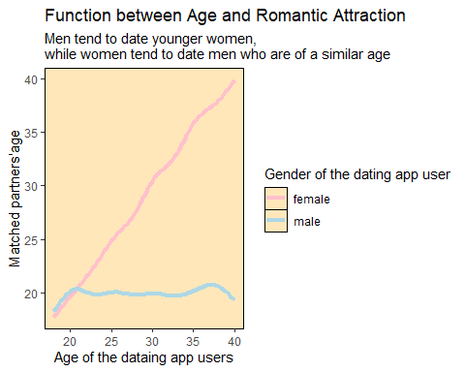
And here is what we got

Slide 8
If you are interested, welcome to our profession

